Slide 1
Y11 into 12 Transition Work
Understand how globalisation and resilience are important characteristics for a country.
Create detailed case study fact files that will be used in both human and physical geography.

Slide 2
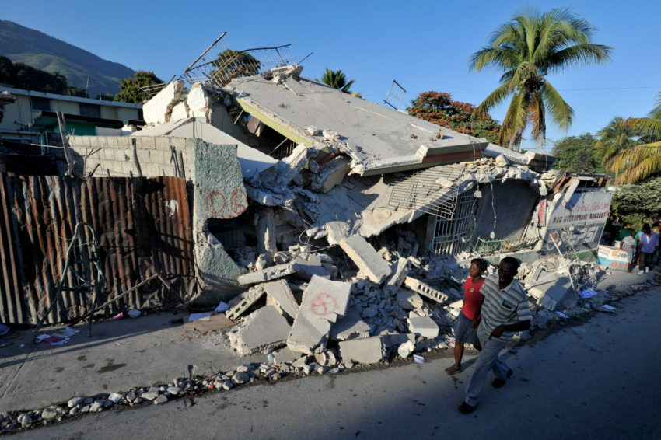
Physical Geography (Dr Allan and Mrs Doherty)
Task:
Create and compare detailed case studies for the earthquakes that occurred in Sichuan, China (2008), Haiti (2010) and Eastern Japan (2011). Which was the most significant?
Magnitude
Type of economy (GDP)
Injuries/ deaths
Economic cost
Success Criteria:
Locate each case study in detail - a map and written description​.
Include social, economic and environmental effects of each earthquake.​
Include the key words and definitions​.
Must show the courses of your research (i.e. how did you obtain the information).
Key Term:
Resilience
Resilience is the ability of a community to cope with a hazard; some communities are better prepared than others so a hazard is less likely to become a disaster. It also includes the ability to return to normal following a disaster.

Slide 3
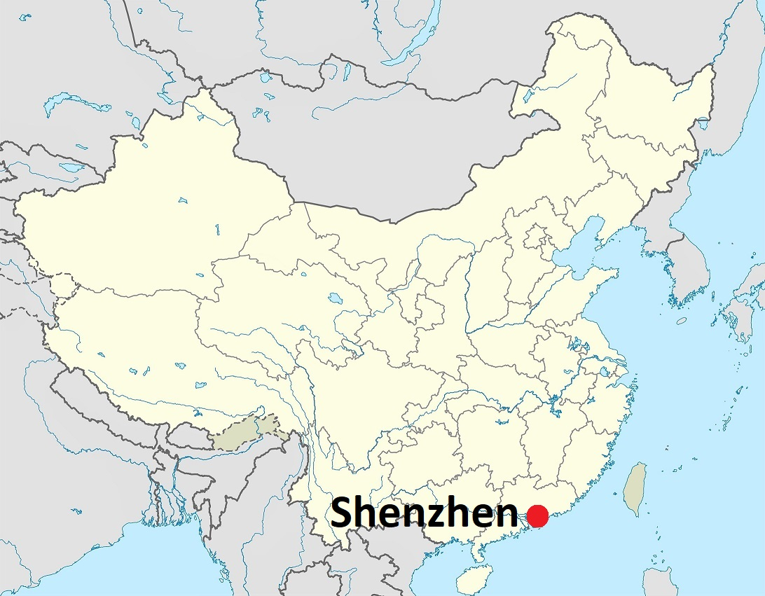
Human Geography (Mrs Stewart)
Task:
Create a detailed case study on how Shenzhen (China) has changed over the past 50 years.
Containerisation
Special economic zone
Open door policy
Success Criteria:
Located in detail - a map and written description​.
Annotated photos to show social, economic and environmental changes. ​
Include the key words and definitions​.
Must show the courses of your research (i.e. how did you obtain the information).
Key Term:
Globalisation
Globalisation is the process by which the world is becoming increasingly interconnected as a result of massively increased trade and cultural exchange. It has increased the production of goods and services. The biggest companies are no longer national firms but transnational or multinational corporations with branches in many countries.

Slide 4
Exam Question
Task:
Based on your research, answer one of these questions.
Assess the extent to which a country (or countries) has been able to meet the pressure placed upon it by a major disaster. (12 marks)
Or
Assess the extent to which the globalisation of trade can bring problems as well as benefits. (12 marks)

Slide 5
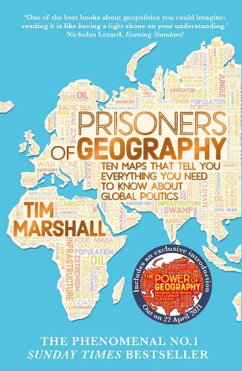
Globalisation
Tectonic Processes and Hazards
Globalisation
Resilience
Ask the Geographer
Podcasts
@thecuriousgeographer
Globalisation is a long-standing process which has accelerated because of rapid developments in transport, communications and businesses.
Disaster occurrence can be explained by the relationship between hazards, vulnerability, resilience and disaster.

