Slide 1
ENGINEERING TRANSITION WORK BOOKLET
Miss Chester

Slide 2
How to be prepared for Engineering
For your first lesson… We expect you to have the following: ​
A level arched folder (thicker folder) – labelled with your name on and Engineering (spelt correctly). ​
A scientific calculator ​
Your own lined paper
Plenty of plastic wallets.
A pencil case with the usual Pen, Pencil, Ruler, Pencil Sharper, Compass, Rubber and Highlighters
Your task homework contained in this booklet
Well done! You’re all set ready to embark on your Level 3 Engineering course. We look forward to seeing you in September!

Slide 3
What will I learn?
Unit 1 | You will be assessed through a number of short- and long-answer problem-solving questions. Learners will need to explore and relate to the engineering contexts and data presented. Assessment will focus on your ability to solve problems that require individual and combined application of mathematical techniques, and electrical, electronic and mechanical principles to solve engineering problems.
Unit 2 | You will examine common engineering processes, including health and safety legislation, regulations that apply to these processes and how individual and team performance can be affected by human factors. You will learn the principles of another important process, engineering drawing, and develop two-dimensional (2D) computer-aided drawing skills while producing orthographic projections and circuit diagrams. Finally, you will work as a team member and team leader to apply a range of practical engineering processes to manufacture a batch of an engineered product or to safely deliver a batch of an engineering service.
Unit 3 | Engineering products are designed as a result of the identification of a need or opportunity, and then engineers using creative skills and technical knowledge to devise and deliver a new design or improvements to an existing design. For example, advances in the development of fuels led to the first internal combustion engine, and engineers have been improving its design ever since. In this unit, you will examine what triggers changes in the design of engineering products and the typical challenges that engineers face, such as designing out safety risks. You will learn how material properties and manufacturing processes impact on the design of an engineering product. Finally, you will use an iterative process to develop a design for an engineering product by interpreting a brief, producing initial ideas and then communicating and justifying your suggested solution.
Unit 45 | You will examine the technology and characteristics of the additive and finishing processes that are needed to manufacture a product or component. You will investigate design changes required to move from a traditional manufacturing process, such as machining and casting, to an additive process and the additional finishing processes that may be needed as a result. Finally, you will design a component that is suitable for manufacture using an additive process and manufacture your component using a 3D printer

Slide 4
How will I be graded?
 | Externatnal (Exam) | Internal (Coursework)
Year 12 | Unit 1: Engineering Principles | Unit 2: Delivery of Engineering Processes Safely as a Team
Year 13 | Unit 3: Engineering Product Design and Manufacture | Unit 45: Additive Manufacturing Processes
Exam:⅓ of grade
Coursework:⅔ of grade
You will have the opportunity of a resit for the exam’s

Slide 5
How will I be graded?

Slide 6
Tell me about yourself
Why choose Engineering?
In this simple task you get the opportunity to tell me your choices and reasons behind choosing to study Engineering. Please answer all questions as best you can.
1. Why are you considering studying Level 3 National Engineering?
2. What other courses are you considering studying at Key Stage 5, and what made you choose this combination?
3. What are you hoping to achieve from studying Level 3 Engineering ?
4. How would you describe yourself as a learner at GCSE? What skills where you good at, what areas would you like to improve on?
5. What are your other hobbies and interests outside of school? Anything related to Engineering?

Slide 7
Engineering Job Profiles
Complete the quiz on Tomorrow’s Engineers:
https://www.tomorrowsengineers.org.uk/students/meet-the-future-you-careers-quiz/
Once you have completed the quiz pick two of the different types of engineers they have recommended and create a profile. In this profile include qualifications required (or routes to get into this type of engineering), what type of work they do, where might they work, how their work is important/ useful.

Slide 8
Job Profile 1 |  | Job Profile 2
Job title |  | Job title
Qualifications required |  | Qualifications required
Routes to get into this type of engineering |  | Routes to get into this type of engineering
What type of work they do |  | What type of work they do
Where might they work |  | Where might they work
How their work is important/ useful |  | How their work is important/ useful

Slide 9
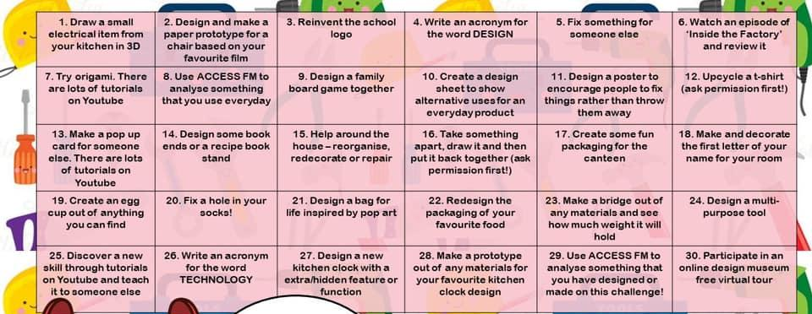
ENGINEERING EVERY DAY TASK: ATTEMPT TO SEE IF YOU CAN DO SOMETHING DESIGN/ENGINEERING RELATED EACH DAY FOR A WHOLE MONTH.

Slide 10
Health and Safety
Task:
Research and complete the table below.
This will be really useful revision tool for you.
 | Meaning
Health and Safety at Work etc Act 1974
Reporting of Injuries, Diseases and Dangerous Occurrences Regulations 2013
Personal Protective Equipment at Work Act 1992
Control of Substances Hazardous to Health Regulations 2002
Manual Handling Operations Regulations 1992

Slide 11
Material properties
Task:
Research and complete the table below.
This will be really useful revision tool for you.
Properties | Mechanical/physical | Meaning | Properties | Mechanical/physical | Meaning
Shear |  |  | Tensile
Electrical conductor |  |  | Thermal insulator
Hardness |  |  | Electrical insulator
Thermal conductor |  |  | Torsional
Compressive |  |  | Ductility

Slide 12
NEA- Covid 19 Design Challenge
1 page introducing what context you are designing for and research on the problem
Task:
Design a product that will help people in one of the following contexts:
Home office
Family Living
Boredom
Home exercising
Social distancing
Part:
1 page introducing what context you are designing for and research on the problem
1 page displaying your different ideas explaining your problem solving. Draft multiple ideas to show creative process
1 page communicating your best and final design. Make sure to include some text to help communicate your genius idea with details on materials, sizes etc

Slide 13
NEA- Covid 19 Design Challenge
1 page displaying your different ideas explaining your problem solving. Draft multiple ideas to show creative process

Slide 14
NEA- Covid 19 Design Challenge
1 page communicating your best and final design. Make sure to include some text to help communicate your genius idea with details on materials, sizes etc

