Slide 1
Computer Science Transition workbook
The course is assessed by 2 exams (40% each) and a programming project ( 20%)
The topic of Computer Science is at the heart of the modern world
Studying it can make you extremely sought after in todays job market
The transition from GCSE to A level is significant, this includes:
An increased emphasis on technical content
An increased emphasis independent research
This workbook is designed to allow you to practice some of these skills and build on your existing knowledge.

Slide 2
Contents
Introduction Tell me about yourself Slide 3
Week 1 Emerging computer technology Slide 4
Week 2 Thinking like a computer Slide 5
Week 3 The Cornell method of note taking Slide 6
Week 4 Getting to grips with terminology Slide 7
Week 5 Why is computer science important? Slide 8 - 9
Week 6 Augmented reality Slide 10 - 11
*Programming challenge can be done in addition to weekly tasks Slide 12

Slide 3
“Tell me about yourself”
Why choose Computer Science?
Expected time to complete: ½ hour
In this simple task you get the opportunity to tell me your choices and reasons behind choosing to study Computer Science. Please answer all questions as best you can.
1. Why are you considering studying A level Computer Science?
2. What other courses are you considering studying at Key Stage 5, and what made you choose this combination?
3. What are you hoping to achieve from studying Computer Science?
4. How would you describe yourself as a learner at GCSE? What skills where you good at, what areas would you like to improve on?
5. What are your other hobbies and interests outside of school? Anything related to Computing?

Slide 4
1
Independent research task
Emerging computer technology
Expected time to complete: 2 hours
In this task you get to investigate any area of emerging computer technology which interests you.
You can pick any area which interests you, but examples could be:
Artificial intelligence
Robotics
Automated self driving cards
Quantum computing
In no more than ONE side of A4 summarise the area you have chosen under the following four headings:
What is it?
What are the possible Social, Moral, Cultural and Ethical benefits of this technology on society
What are the possible Social, Moral, Cultural and Ethical risks of this technology on society
My conclusion on this technology and what it will mean for our world 10 years from now
Additional help:
For additional help and support in structuring your answer you might like to watch some of the videos from the following Craig ‘n’ Dave playlists:
OCR:
SLR 17 – Ethical, morale and cultural issues
https://student.craigndave.org/videos/slr-17-ethical-moral-and-cultural-issues

Slide 5
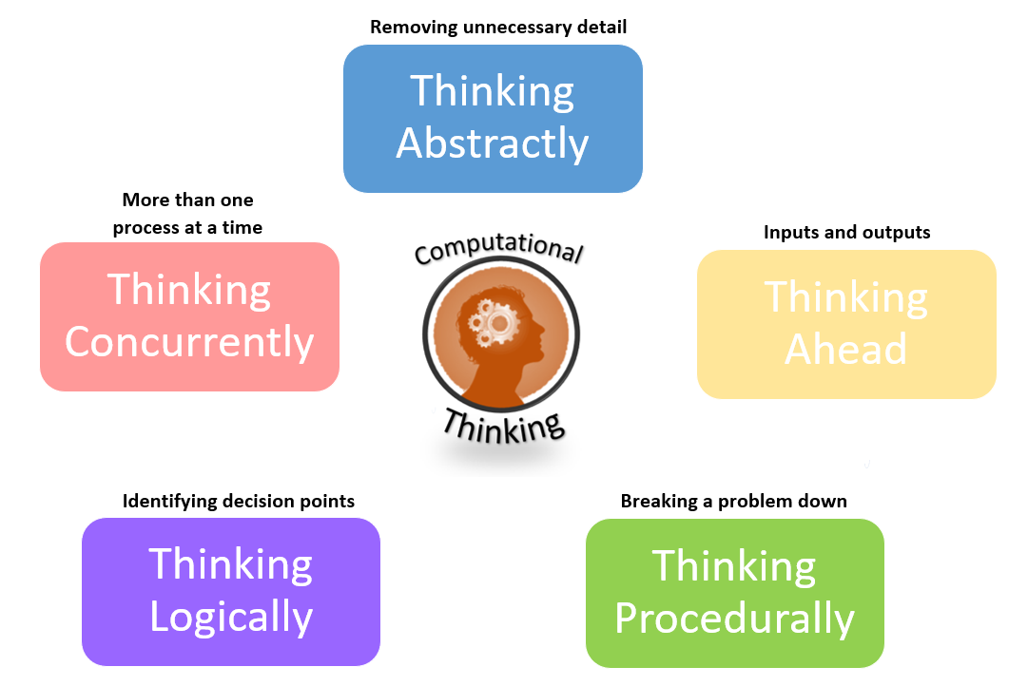
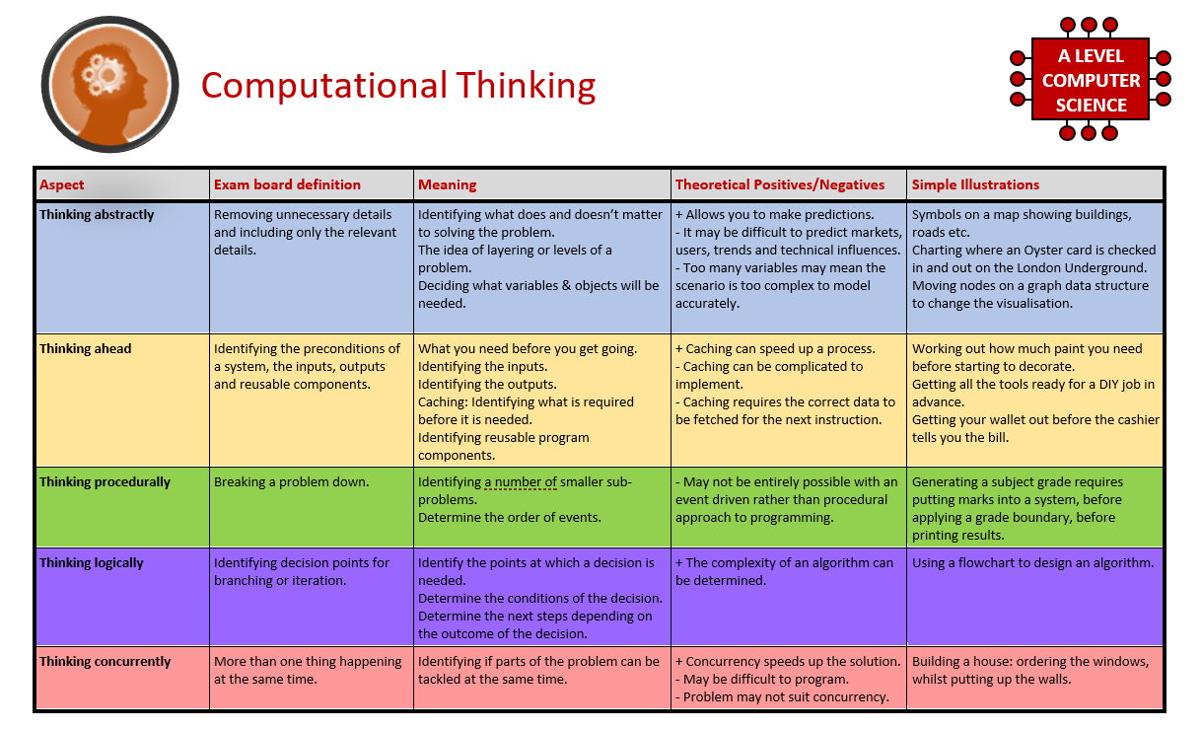
2
What is “computational thinking”?
Thinking like a computer
Expected time to complete: 2 hours
At the heart of Computer Science is the ability to look at problems, analyse them, break them down and solve them in a way which involves a variety of “Computational Thinking” skills.
Download the “Computational thinking and Computational methods placemats” from Craig n Dave:
https://student.craigndave.org/specification-key-terminology-and-cheat-sheets
Create your own spider diagram / mind map which shows your clear understanding of the 5 different computational thinking strands
Keep it to a single side of A4 / A3
Your goal is to imagine someone else has to revise from your mind map. Ask yourself:
Does it make sense?
Is it clear?
Does it cover all of the important concepts?

Slide 6
3
Note taking practice task
The Cornell method of note taking
Expected time to complete: 1½ hours
The expectation to do independent research at A Level will increase dramatically from GCSE.
There is a real skill to taking decent notes outside of lesson which are of value. Research has proven that one of the most effective methods is the “Cornell” note taking method.
To start download the “Cornell note taking template” from Craig n Dave:
https://craigndave.org/product/cornell-note-taking-template/
Pick any two of the following videos from Craig ‘n’ Dave:
OCR: https://student.craigndave.org/videos/ocr-alevel-slr01-alu-cu-registers-and-buses
OCR: https://student.craigndave.org/videos/ocr-alevel-slr04-paging-segmentation-and-virtual-memory
OCR: https://student.craigndave.org/videos/ocr-alevel-slr05-stages-of-compilation
OCR: https://student.craigndave.org/videos/ocr-alevel-slr14-data-structures-part-2-graphs
Write the title of the video and its topic in the top boxes (use a different sheet for each video).
In the main “Notes” section, write notes from the video. You can do this in any way you like, a suggestion might be to rewind slightly when the canvas changes, thinking carefully about what was important in the previous few minutes.
Having recorded the notes, review them:
Turn each part into a question in the section on the left.
For example, the notes may say, “The value of the program counter is passed to the memory address register”.
The question then becomes, “which register is the value of the program counter passed to?”
Sometimes these questions are easy, and at times they are more difficult to write.
There may also be more than one valid question.
You will need to decide for yourself which are the most appropriate questions for revision.
Finally pull out all the key words and their definitions words the notes and list them in the bottom section.

Slide 7
4
Key terms task
Getting to grips with terminology
Expected time to complete: 2 hours
An important aspect of being successful with your study of Computer Science is getting to grips with subject related terminology. There are over 240 specific terms you will need to learn!
Below are a handful of the key terms you will need to become familiar with.
Control Unit Register Busses
Von Neuman Architecture Optical Storage Operating System
Intermediate Code Device Driver Compiler
Assembly Language Machine Code Lossy Compression
Hashing Normalisation TCP/IP Stack
Packet Switching ASCII Problem Decomposition
Research each of the key terms and write a definition.
Resist the urge to simply cut and paste a definition from the first website you find. Many definitions found on The Internet are overly complicated and wordy.
Ask yourself:
Does my definition make sense?
Is it succinct, to the point?
Does the definition have appropriate depth and detail for A’Level?
Could I give this definition to another student so they could revise from it?

Slide 8
5
Critical thinking task
Why is Computer Science important?
Expected time to complete: 2 hours
It is easy to say, “Computer Science is essential in todays world”, but are you able to think critically about this statement and back it up? “Thinking Critically” is an essential skill at A Level.
It involves you:
Looking at a topic / concept in depth
Taking account of different views / perspectives
Considering positives and negatives
Evaluating links and effects on other concepts
Drawing your own conclusions backed up with evidence
On the following slide answer the questions:
What is Computer Science?
What are the benefits and risks of Computer Science at a local level (think about your local community / town / city / county)
What are the benefits and risks of Computer Science at a national level
What are the benefits and risks of Computer Science at a global level
Additional help:
For additional help and support in structuring your answer you might like to watch some of the videos from the following Craig ‘n’ Dave playlists:
OCR:
SLR 17 – Ethical, morale and cultural issues
https://student.craigndave.org/videos/slr-17-ethical-moral-and-cultural-issues

Slide 9
5
Critical thinking task
Why is Computer Science important?
Expected time to complete: 2 hours
What is Computer Science?
Enter your answer here
What are the benefits and risks of Computer Science at a local level
Enter your answer here
Try to make at least 4 valid points
What are the benefits and risks of Computer Science at a national level
Enter your answer here
At least 2 of your points should be about the potential risks of Computer Science
At least 2 of your points should be about the potential benefits of Computer Science
Try to make at least 4 valid points
At least 2 of your points should be about the potential risks of Computer Science
At least 2 of your points should be about the potential benefits of Computer Science
What are the benefits and risks of Computer Science at a global level
Enter your answer here
Try to make at least 4 valid points
At least 2 of your points should be about the potential risks of Computer Science
At least 2 of your points should be about the potential benefits of Computer Science

Slide 10
6
Applying technical knowledge in context task
Augmented reality
Expected time to complete: 1½ hours
A key skill at A Level is being able to take a topic and then discuss it in the context of different scenarios.
Most theory-based exam questions will be asked in the form of a scenario, simply regurgitating what you know on the topic without contextualising your answer to the scenario will often result in low marks!
The topic for this exercise is “Augmented Reality”. It is a truly fascinating area of technology which has the potential to change almost every aspect of our daily lives.
Watch this brief video to learn more: https://www.youtube.com/watch?v=vQtwWzfzKXI
After watching the video complete the next slide which asks you to discuss the benefits, limitations and risks of augmented reality in the context of:
Medicine & health care
Gaming & entertainment
Schools & learning
Travel & tourism
Social media
Transport & navigation
Image by Oyundari Zorigtbaatar (20 March 2016) https://creativecommons.org/licenses/by-sa/4.0/legalcode

Slide 11
6
Applying technical knowledge in context task
Augmented reality
Expected time to complete: 1½ hours
Medicine & health care
Discuss the benefits, limitations and risks of augmented reality in this context:
Enter your answer here
Gaming & entertainment
Discuss the benefits, limitations and risks of augmented reality in this context:
Enter your answer here
Schools & learning
Discuss the benefits, limitations and risks of augmented reality in this context:
Enter your answer here
Travel & tourism
Social media
Transport & navigation
Enter your answer here
Discuss the benefits, limitations and risks of augmented reality in this context:
Discuss the benefits, limitations and risks of augmented reality in this context:
Enter your answer here
Discuss the benefits, limitations and risks of augmented reality in this context:
Enter your answer here

Slide 12
An introduction to the basics of programming tasks
Programming basics
Expected time to complete: 6 hours
Learning to “code” is a fun and essential part of A Level Computer Science. This task is ideal if you haven't done the GCSE in Computer Science or you simply want a nice refresher ahead of starting your A Level course.
Head over to the web site: https://www.learnpython.org/
Complete the following python tutorials under the heading:
• Hello, World!
• Variables and Types
• Lists
• Basic Operators
• String Formatting
• Basic String Operations
• Conditions
• Loops
• Functions
Each section presents you with theory, code to run and exercises to try out.
If you want to practice writing your own python programs you can download and install a simple python development tool here: https://www.python.org/downloads/
Additional note:
This task is most suited to students who intend to do the A Level and have not previously gained much / or any programming experience from the GCSE Computer Science course.

