Slide 1
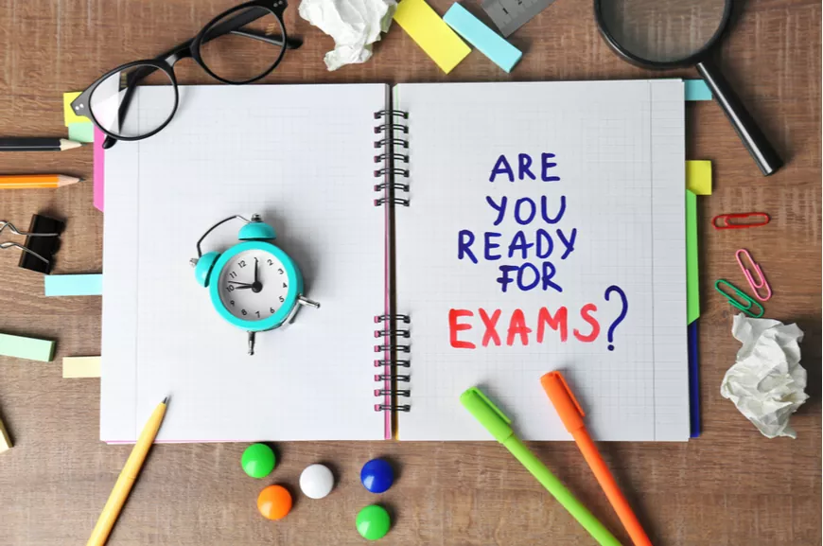

Slide 2
Getting Exam Ready
Preparing for exams does take time and effort.
Everyone is different, so there’s no ideal plan we can give you, but in this guide are some planning points which we know have been successful in the past.
Remember that your teachers are here to help you and they want to support you in your learning and revision.
So, if you get stuck, please ask for their help.
We wish you the best of luck with your exams and we hope that you will be delighted with your results in August 2022.

Slide 3
Studying
This is one of the hardest things to do.
Now you are in your last weeks of Year 11, it is vital that you make sufficient time for exam preparation.
For the next few weeks, some other activities might need to be put on hold until after the exam.
Think about what has got to give way and where you can turn ‘down time’ into ‘study time’.
Sacrifices should be less difficult now the exams are getting closer.

Slide 4
Learn
Make the most of the lesson time!
Learning takes place in class.
It is important that you fully understand each topic before you can revise it.
If there is anything that you don’t fully understand, re-read the textbook, ask your teacher, ask another student to go over the topic with you.

Slide 5
Revise
Once you have fully mastered a topic, you can start to
revise it.
There are many different ways to revise:
condense your notes (e.g. using The Cornell notetaking method)
create mind-maps or flow-charts
prepare flashcards from your notes (question on one side, answer on the back)
convert your notes into your own podcasts, etc.
Revision is not re-reading your notes over and over again! You need to do something with your notes instead!

Slide 6
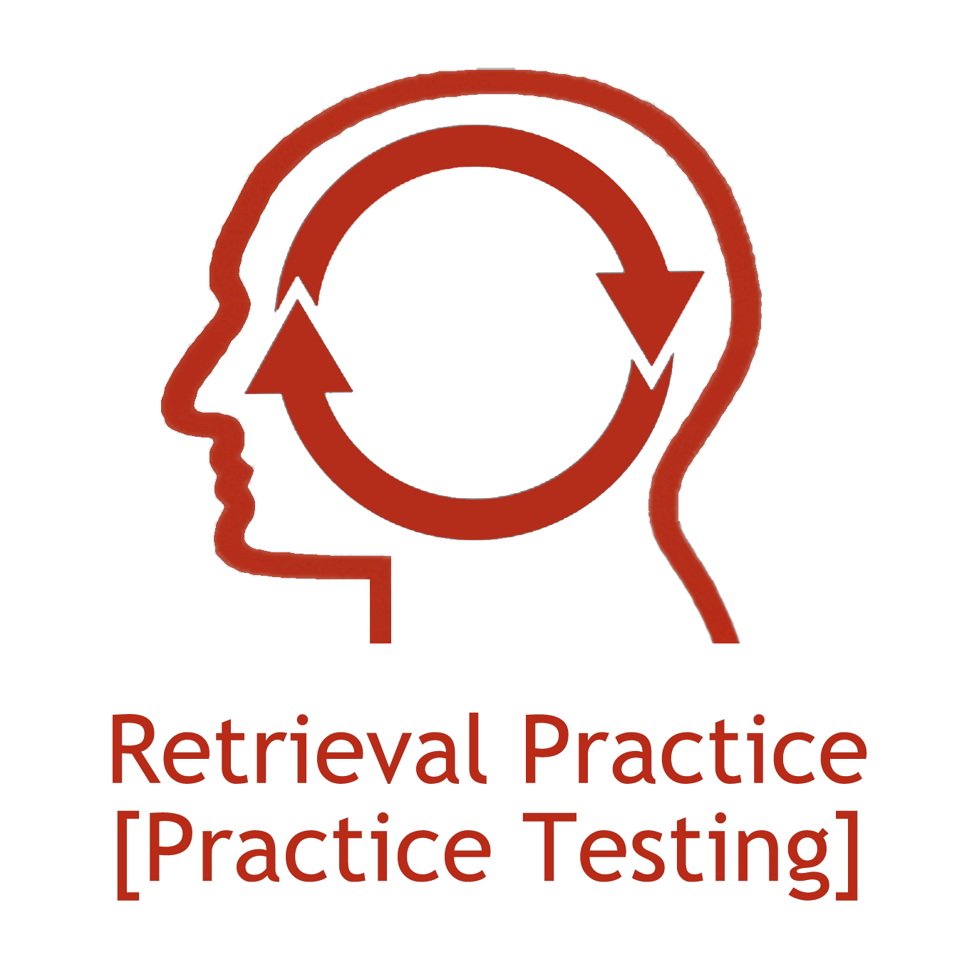
Retrieve
Once you have revised a topic, you are ready to test yourself:
ask a friend or family member to test you on your flash cards
re-draw your mindmaps or flow charts from memory
complete past paper questions
use MyGCSE Science, GCSE Pod; Mathswatch etc

Slide 7
Revision takes time and effort and a lot of your energy.
You do not need to stay at home and study all the time, however, try and avoid any activities that leave you drained and exhausted the next day.
Make sure you eat sensibly and drink plenty of water.
Moderate exercise and plenty of sleep are also important.
Remember that you should stop revising one hour before you intend to go to sleep. If you don’t allow for some down time after revision, it is likely that you will find it harder to fall asleep straight away.

Slide 8
It is natural to feel a bit of tension as the exam season is drawing closer.
Remember that if you have organised your time, started revision early and kept to your revision timetable, you are going to be fine.
If you are worried, try to identify what it is that is bothering you and talk about it with your parents and teachers.
The chances are that you can do something about it.

Slide 9
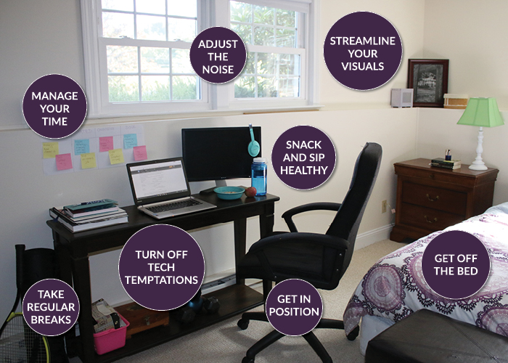
Study Space
If the place where you do most of your school work is not easy to work in, what can you do to make it better?
What distracts you when you are trying to settle down to revision?
Can you do something to remove that distraction (e.g. place your phone into a lockable box or different room)?
If you find it difficult to study at home, arrange to stay longer in school to attend revision.

Slide 10
Equipment & Resources
Pens
Coloured pencils
Highlighters
Paper
Folders
Dividers
Flashcards
Post-it notes
Ruler & protractor
Eraser
Calculator
Dictionary
Revision guides
Exercise books
Textbooks
Past papers
Markschemes
Examiners reports

Slide 11
Study Plan
Before you start your revision it is essential that you know what needs to be revised in each subject. Often your teacher will provide you with a checklist or exam specification which makes it also clear which topics are on which exam paper.
You can use the exam board specification to divide the task up into a lot of smaller topics (it is easier to get started and to see your progress if you divide one large topic into a series of smaller topics). This means that each topic is fairly quick which keeps up your motivation to continue with your revision

Slide 12
Study Plan
Example: Chemistry Topic 5.9.1 The composition and evolution of the Earth’s atmosphere
Specification topic | Made revision notes | Revised the notes | Tested myself | Need help
Know the proportion of gases in atmosphere
Know the composition of the Earth’s early atmosphere
Describe the process by which the level of oxygen in the atmosphere increased
Describe the process by which the level of carbon dioxide in the atmosphere decreased

Slide 13
Study Timetable
Make a study timetable for which topics you will cover each week.
With a study timetable you are able to check that you are covering all subjects and are not running out of time.
Aim to study a little every day (2 hours a day initially)
Build in some unallocated study time because you may get a bit behind.
Put the timetable up on the wall or fridge at home where everyone can see it. Ask your family to help you keep to it.
If you find that you are repeatedly not sticking to your study timetable, find out why you are struggling to keep to it and rewrite it!

Slide 14
Weekly Study Timetable
 | Monday | Tuesday | Wednesday | Thursday | Friday
3.45pm (Monday 2.45pm) | After school revision | After school revision | After school revision | After school revision | After school revision
5pm | Maths | Football | Football | History | Out with friends
6pm | French | English | Photography | Maths | Out with friends
7pm | Break | Art | Geography | Break | Out with friends
8pm | Science | History | Break | Science | Out with friends

Slide 15
The Pomodoro Method
Select a task or topic
Set a timer for 25mins
Work until timer goes off
Take a 5 minute break
Repeat until you have finished revising the topic

Slide 16
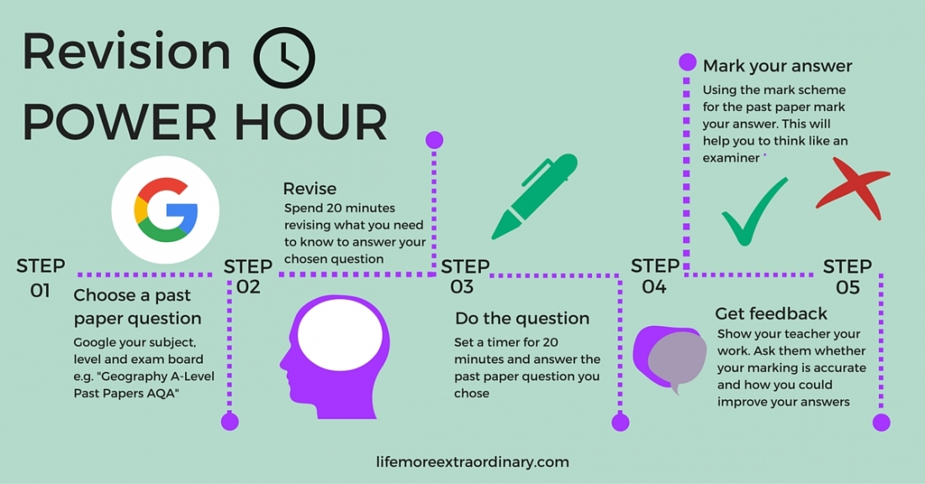

Slide 17
Memorise
Choose a topic, or part of a topic.
Spend time reading through the topic in your revision guide, textbook or exercise book.
Cover up the information that you have just read and write down everything that you remember on a blank piece of paper.
Then check what you wrote against the original notes.
Highlight the areas you have missed or did not remember correctly.
Then repeat the process until you can remember everything correctly.

Slide 18
Self Quizzing
One of the best revision techniques is to quiz yourself (or get someone else to quiz you).
Use the notes from the revision guide, textbook or exercise book to create a set of questions and answers (on paper or flashcards).
If you make flashcards, remember to write the question on one side and the answer on the other side of the same card.

Slide 19
Self Quizzing
Using this technique, you will find out exactly how much you have forgotten about a topic.
Forgetting is a normal process. Quiz yourself more often on the questions you get wrong or forget.
Don’t stop quizzing yourself on the questions you get right.
Repeated quizzing is required to transfer the information into your long-term memory.

Slide 20
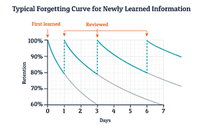
Spacing
Leave time between quizzing sessions.
Once you feel confident that you remember everything about a particular topic, allow some time to pass before returning to that topic (a few days or even a week).
Over this time, you will start to forget some of the information.
This means you will need to try hard to recall the information, which helps with the information being committed to long-term memory.

Slide 21
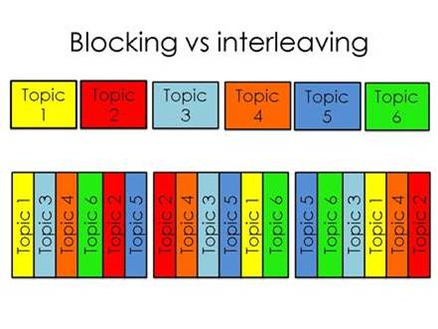
Interleaving
Don’t study one subject or topic for too long.
When you go back through your flashcards or notes, go through them in a different order
If you spend too much of your time on one subject, either because it is your favourite one or because it is known to be weak, the other subjects will suffer.
It is very common for students to get their best results in subjects they found difficult - because they neglected their stronger subjects during revision.

Slide 22
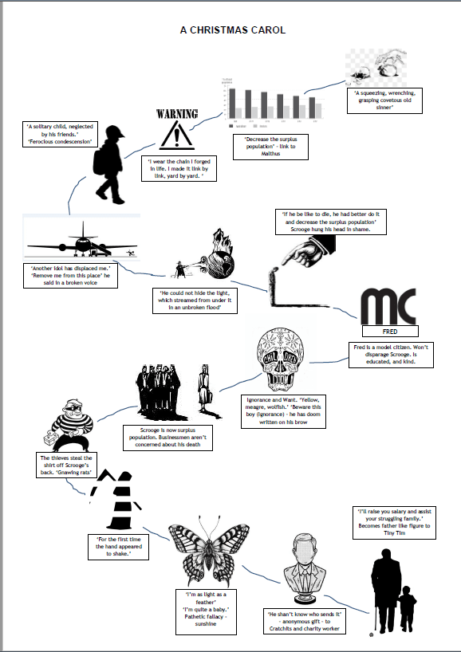
Dual Coding
For some people it helps to draw diagrams to go along with the notes:
You can also cover up the notes and use the diagrams/drawings as clues to explain/recall a concept. Don’t forget to check for accuracy against your notes afterwards

Slide 23
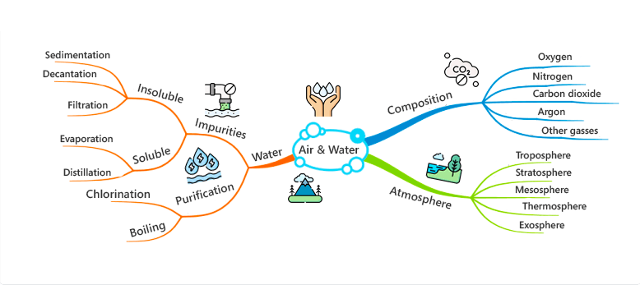
Mind Maps
Create a mind map on a topic.
Use the mind map to test yourself
Turn the mindmap into explanation and descriptions and check these for accuracy.

Slide 24
Revision Websites
Remember to use revision websites and online learning programmes to help you:
MyGCSE Science has videos to watch, quizzes to test yourself and past exam questions.
Mathswatch has videos, quizzes and questions.
GCSE Pod has lots of videos and questions for many subjects.

Slide 25
Examiner Reports
Every year, the exam boards make public a document that is written by the examiners.
In this document the examiners summarise:
what the most common errors were
which questions were answered well and what this good answer looked like (e.g. examiners have given high marks for answers that offer criticisms to viewpoints during an evaluation question).
Examples of what not to do are also included.
This is incredibly useful to use during your revision. Read it carefully, turn it into notes, diagrams etc.
Ask your teacher for a copy.

Slide 26
Past Exam Papers
Once you know off by heart the information from your notes and flashcards, you need to move on to past papers to see how the specification is tested/examined.
Most students will complete each past paper once, however, you should complete each past paper at least twice.
The first time round you might have to use your notes to answer some of the questions.
Then go through the markscheme. Only accept answers that are worded exactly like the markscheme. If you are unsure if you can award yourself a mark for an answer, ask your teacher for advice. You know what you wanted to say, but that does not mean the examiner will interpret your answer the same way and very often the examiner wants to read a very specific phrase. It is important that you do not overmark your answers.
The second time round, you should complete the paper without any of your notes and under timed conditions so you get used to the time pressure you will be under in the exam.

Slide 27
Now for the exams
The hard work is done. Your revision has met its end and now is the perfect time to calm your nerves and make sure that you are ready to enter the exam hall well rested and confident in your ability to answer the questions on the paper.

Slide 28
In the exam
Set out your equipment.
Imagine yourself on results day: visualise opening your results and being delighted with the outcome.
Focus on slowing your breathing to help you relax (inhale for 4 counts - hold your breath for 4 counts - exhale for 4 counts – repeat).
Listen carefully to the invigilator.
Read the written instructions on the front of the exam paper carefully. These will tell you: time, choice of questions, type of answer, number of marks.
Fill in the centre number, candidate number and your name.
Read each question slowly. Highlight or underline command words and essential information. Then read the question again.
Think about a general plan for the answer before writing down your answer.

Slide 29
What if my mind goes blank?
Focus on your breathing to calm your nerves.
Jot down some initial thoughts.
Move on to the next question if you still feel you cannot answer the question.
Return to the question you struggled with at the end of the exam once you have answered all the other questions.

Slide 30
At the end of each exam
It is natural to discuss answers with other students once the exam is over, however, don’t bother with a full post-mortem. You have done your best.
Physically and mentally, pack up your revision notes for that exam and move on to the next subject and exam.
Think about the type of question you found most difficult.
If you know that the same style of question will come up in another exam, make sure you practise answering these types of questions before the next exam.

Slide 31
Changing Your Mindset
Unhealthy Self Talk | Healthy Self Talk
I am going to fail. | My friends and family love me, whatever happens.
All my friends are going to do better than me | I belong to a school community and they want me to try my best, that is all.
I can’t go to sixth form/Uni/college unless I get the grades. | As one door closes, another one opens.
Exams are everything. | This is an important stage of my life but there are many adventures ahead.
I can’t do these exams | I can only do my best

Slide 32
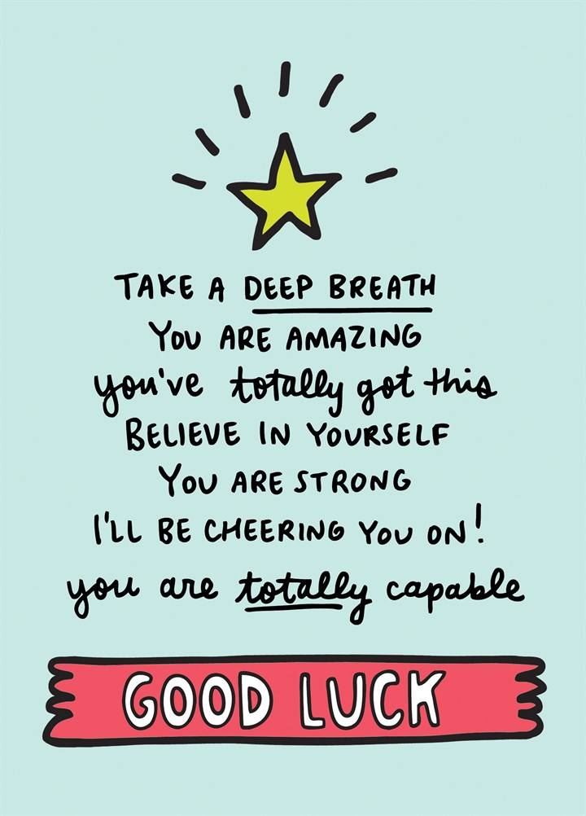
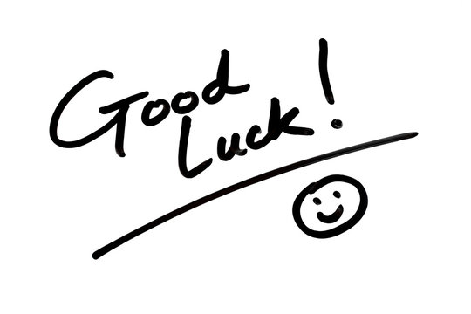

Slide 33
Thursday
25th August
2022
Time: tbc

